Slide 1

Green University of Bangladesh
Department of Computer Science and Engineering (CSE)
Faculty of Sciences and Engineering, Semester: (Fall, Year:2021),
B.Sc. in CSE (Day)
Course Title: Microprocessor & Microcontrollers Lab
Course Code: CSE 304
Section: 202DA
Project Report
Student Details
Name |  | ID
1. | Kowsar Ahmed Sojol | 183002049
2. MD.Belal Hossen 183002127
Course Teacher’s Name
: Md. Rajibul Palas
[For Teachers use only: Don’t Write Anything inside this box]
Lab Project Status
Marks: …………………………………
Signature: .....................
Comments: ..............................................
Date: ..............................

Slide 2
Table of Contents
Chapter 1 Introduction
Acknowledge
Introduction
Objective
01
01
01
Chapter 2 Project Development
Instruction
Source code
02
03-10
Chapter 3 Implementation
Overview
11-17
Chapter 4 Conclusion
Scope of Future Work:
Require Software
Hardware
Results and Discussions
Reference
18
18
18
19
19

Slide 3
Chapter 1 Introduction
ACKNOWLEDGEMENT:
This Project is completed by the support from our honorable Teacher Md. Rajibul Palas. We are greatly indebted to our beloved teacher for her useful and necessary observation, suggestions and contribution. We could not have been able to achieve anything in this project without her supervision. May Allah enrich her greatly in every area of life.
Kowsar Ahmed Sojol &
MD.Belal Hossen
Introduction
Assembly Language is a very important course for a student who studied the Computer Science and Engineering subject. In this course, we learned the concept of assembly language. At first, we learned the basic concept about assembly language. From the acquired knowledge of this course finally, we designed a Restaurant Management system . We have tried our best to make the complicated process of Restaurant Management System as simple as possible. We have tried to design the Project in such a way that user may not have any difficulty in using this package & further expansion is possible without much effort.
Objective
The main objective of this project is to establish an integrated Restaurant Management system . Specific Objective:
=> The program will show the foods names and pricings list. The program will calculate the total products values and quantities and will display it to the user. User can also reset the records of products. After completing the purchase user can exit the program
=> A computer based management system is designed to handle all the primary
information required to calculate order number, order list, price and handle all the details required for the correct statement calculation and generation.
=> This project intends to introduce more user friendliness in the various activities such as take order, pay bill, and hassles less.
=> The ordering of foods has been made quite simple as all the details of the customer can be obtained by simply keying in the menu book.
Page 01

Slide 4
Chapter 2
Project Development
Instruction:
We have used some Assembly Language functions in our project. These are
DB - stays for Define Byte. can be any
letter or digit combination, though it should start with a letter.
DW - stays for Define Word. can be any letter or digit combination,
though it should start with a letter.
Stack - The stack segment register is usually used to store information about the
memory segment that stores the call stack of currently executed program.
Mov - The MOV instruction is the most important command in the 8086
because it moves data from one location to another.
Proc - A procedure is a set of code that can be branched to and returned
from in such a way that the code is as if it were inserted at the point from
which it is branched to. The branch to procedure is referred to as the call,
and the corresponding branch back is known as the return.
DS – Data segment register.
AX - This is the accumulator. It is of 16 bits and is divided into two 8-bit
registers AH and AL to also perform 8-bit instructions.
DX – This is the data register. It is of 16 bits and is divided into two 8-bit
registers DH and DL to also perform 8-bit instructions. It is used in
multiplication an input/output port addressing.
Offset - The OFFSET operator returns the offset of a memory location
Page 02

Slide 5
Source Code :
.model large
.stack 1000h
.data
m1 db 10,13,10,13,' ****welcome to our green garden restaurants****$',10,13
m2 db 10,13,10,13,'Enter your choice $'
m3 db 10,13, ' 1.breakfast $'
m4 db 10,13, ' 2.lunch $'
ms5 db 10,13,' 3.dinner $'
m5 db 10,13, ' 4.snacks $'
m6 db 10,13, ' 5.dessert $'
m7 db 10,13, ' 6.drinks $'
m8 db 10,13,10,13,'***choice your food from the menu***$'
;breakfast
m9 db 10,13, ' ** 1.tanduri roti 10/- **$' ;breakfast
m10 db 10,13,' ** 2.nan 10/- **$'
m11 db 10,13,' ** 3.parata 10/- **$'
m12 db 10,13,' ** 4.dal 10/- **$'
m13 db 10,13,' ** 5.mixed vegetables 20/- **$'
m14 db 10,13,' ** 6.halwa 20/- **$'
m15 db 10,13,' ** 7.luchi 10/- **$'
m16 db 10,13,' ** 8.fried egg 20/- **$'
m17 db 10,13,' ** 9.kichuri 60/- **$'
;lunch & dinner
m25 db 10,13,' ** 1.kachchi birani 90/- **$'
m26 db 10,13,' ** 2.chicken birani 90/- **$'
m27 db 10,13,' ** 3.plain polaw 30/- **$'
m28 db 10,13,' ** 4.chicken bhuna khichuri 90/- **$'
m29 db 10,13,' ** 5.mutton bhuna khichuri 90/- **$'
m30 db 10,13,' ** 6.plain rice 10/- **$'
m31 db 10,13,' ** 7.pabda fish 30/- **$'
m32 db 10,13,' ** 8.lobstar(chingri) 30/- **$'
m33 db 10,13,' ** 9.koi fish 30/- **$'
;dinner
m18 db 10,13,' ** 1.chicken roast 60/- **$'
m19 db 10,13,' ** 2.chicken bhuna khichuri 80/- **$'
m20 db 10,13,' ** 3.mutton bhuna khichuri 80/- **$'
m21 db 10,13,' ** 4.salad 40/- **$'
m22 db 10,13,' ** 5.chicken curry 50/- **$'
m23 db 10,13,' ** 6.spicy beef fry 70/- **$'
m34 db 10,13,' ** 7.hilsha fish 60/- **$'
m35 db 10,13,' ** 8.rui fish 60/- **$'
m36 db 10,13,' ** 9.special vegetable 60/- **$'
;
;snacks
m41 db 10,13,' ** 1.moghol porata 8/- **$'
m42 db 10,13,' ** 2.jali kabab 80/- **$'
m43 db 10,13,' ** 3.singara 5/- **$'
m44 db 10,13,' ** 4.samucha 5/- **$'
;sweat meat
m45 db 10,13,' ** 1.faluda 50/- **$'
m46 db 10,13,' ** 2.puding 50/- **$'
m47 db 10,13,' ** 3.firni 50/- **$'
m48 db 10,13,' ** 4.rasmalai 50/- **$'
Page 03

Slide 6
. ;drinks
m49 db 10,13,' ** 1.soft drinks 8/- **$'
m50 db 10,13,' ** 2.lemon juice 6/- **$'
m51 db 10,13,' ** 3.borhani 9/- **$'
m52 db 10,13,' ** 4.coffee 9/- **$'
m53 db 10,13,' ** 5.lemon tea 7/- **$'
m54 db 10,13,' ** 6.tea 5/- **$'
;invalid
m55 db 10,13,10,13,'***&&invalid entry&&***$'
m56 db 10,13,' ***&&try again&&***$'
m57 db 10,13,10,13,'enter your order: $'
m58 db 10,13,'quantity: $'
m59 db 10,13,'total price: $’
drink db ?
quantity db ?
m60 db 10,13,10,13,'1.go back to main menu$'
m61 db 10,13,'2.exit$'
;star resize
mr1 db 10,13,' ** **$'
mr2 db 10,13,' ***********************************************$'
mr3 db 10,13,' ** **$'
mr4 db 10,13,' ** **$'
mr5 db 10,13,' *******************************************************************$'
mr6 db 10,13,' ** **$'
mr7 db 10,13,' **********************************************$'
sej db 10,13,10,13,' $'
.code
main proc
mov ax,@data
mov ds,ax
top:
lea dx,m1
mov ah,9
int 21h
lea dx,sej ;newline
mov ah,9
int 21h
lea dx,mr2
mov ah,9
int 21h
Page 04

Slide 7
lea dx,mr2
mov ah,9
int 21h ;border
lea dx,mr3
mov ah,9
int 21h
lea dx,m3
mov ah,9
int 21h
lea dx,m4
mov ah,9
int 21h
lea dx,ms5
mov ah,9
int 21h
lea dx,m5
mov ah,9
int 21h
lea dx,m6
mov ah,9
int 21h
lea dx,m7
mov ah,9
int 21h
lea dx,mr1
mov ah,9
int 21h
lea dx,mr2
mov ah,9
int 21h
lea dx,mr2
mov ah,9
int 21h
lea dx,m2
mov ah,9
int 21h
mov ah,1
int 21h
mov bh,al
sub bh,48
cmp bh,1
je breatfast
cmp bh,2
je ld
cmp bh,3
je dinner
Page 05

Slide 8
cmp bh,4
je snacks
cmp bh,5
je sweatmeat
cmp bh,6
je drinks
jmp invalid
breatfast:
lea dx,m8 ;breatfast starts
mov ah,9
int 21h
lea dx,sej ;newline
mov ah,9
int 21h
lea dx,mr5
mov ah,9
int 21h
lea dx,mr5
mov ah,9
int 21h
lea dx,mr4
mov ah,9
int 21h
lea dx,m9 ;item 1
mov ah,9
int 21h
lea dx,m10 ;item 2
mov ah,9
int 21h
lea dx,m11
mov ah,9 ;3nd
int 21h
lea dx,m12
mov ah,9 ;4rd
int 21h
lea dx,m13 ;5th
mov ah,9
int 21h
lea dx,m14 ;6th
mov ah,9
int 21h
Page 06

Slide 9
lea dx,m15
mov ah,9 ;7th
int 21h
lea dx,m16 ;8th
mov ah,9
int 21h
lea dx,m17 ;9th
mov ah,9
int 21h
lea dx,mr4
mov ah,9
int 21h
lea dx,mr5
mov ah,9
int 21h
lea dx,mr5
mov ah,9
int 21h
lea dx,m57
mov ah,9
int 21h
mov ah,1
int 21h
mov bl,al
sub bl,48
cmp bl,1
je ten
cmp bl,2
je ten
cmp bl,3
je ten
cmp bl,4
je ten
cmp bl,5
je twenty
cmp bl,6
je twenty
cmp bl,7
je ten
cmp bl,8
je twenty
cmp bl,9
je sixty
Page 07

Slide 10
lea dx,m49 ;1th
mov ah,9
int 21h
lea dx,m50 ;2th
mov ah,9
int 21h
lea dx,m51 ;3th
mov ah,9
int 21h
lea dx,m52 ;4th
mov ah,9
int 21h
lea dx,m53 ;5th
mov ah,9
int 21h
lea dx,m54 ;6th
mov ah,9
int 21h
lea dx,mr6
mov ah,9
int 21h
lea dx,mr7
mov ah,9
int 21h ;border
lea dx,mr7
mov ah,9
int 21h
lea dx,m57
mov ah,9
int 21h
mov ah,1
int 21h
mov bl,al
sub bl,48
cmp bl,1
je softdrink
cmp bl,2
je laschi
cmp bl,3
je borhani
cmp bl,4
je labang
cmp bl,5
je coffee
cmp bl,6
je tea
jmp invalid
Page 08

Slide 11
softdrink:
mov bl,8
jmp common
laschi:
mov bl,6
jmp common
borhani:
mov bl,9
jmp common
labang:
mov bl,9
jmp common
coffee:
mov bl,7
jmp common
tea:
mov bl,5
jmp common
common:
lea dx,m58
mov ah,9
int 21h
mov ah,1
int 21h
sub al,48
mul bl
aam
mov cx,ax
add ch,48
add cl,48
lea dx,m59
mov ah,9
int 21h
mov ah,2
mov dl,ch
int 21h
mov dl,cl
int 21h
mov dl,47
int 21h
mov dl,45
int 21h
;go back to main menu
Page 09

Slide 12
lea dx,m60
mov ah,9
int 21h
lea dx,m61
mov ah,9
int 21h
lea dx,m2
mov ah,9
int 21h
mov ah,1
int 21h
sub al,48
cmp al,1
je top
jmp exit:
invalid:
lea dx,m55
mov ah,9
int 21h
lea dx,m56
mov ah,9
int 21h
jmp exit
exit:
mov ah,4ch
int 21h
main endp
end main
Page 10

Slide 13
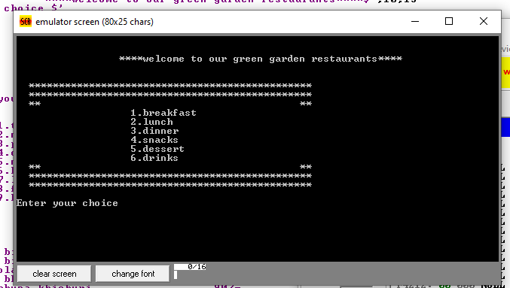
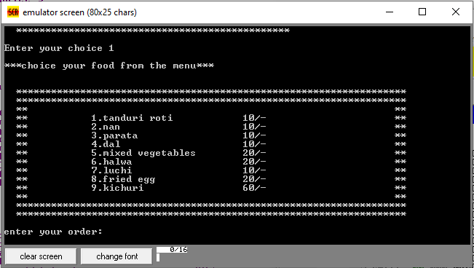
Chapter 3
Implementation
This is our main menu . It has 6 parts . These are :
At first , Clicked 1 for breakfast .Then breakfast menu is open
Page 11

Slide 14
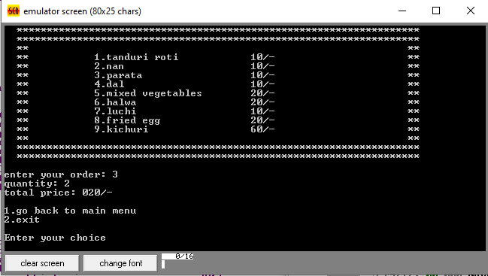
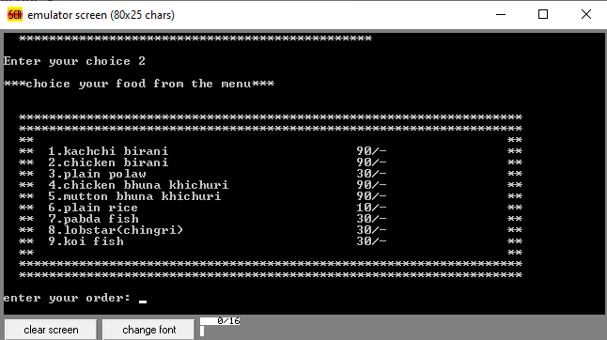
Here , various foods items and their prices available. We can order any
items. Suppose ,we want to order “Parata” so , clicked 3 and Quantity =2
Total price : 20/-
Clicked 1 for go to main menu and clicked 2 for go to lunch menu.
And lunch menu is open
Page 12

Slide 15
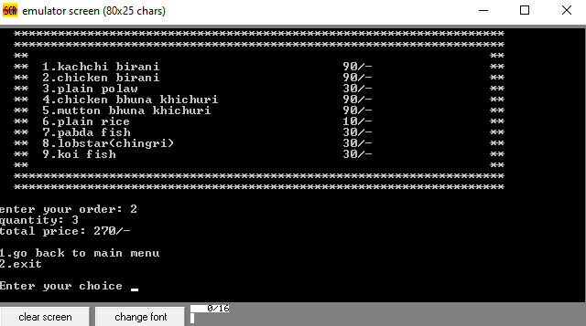
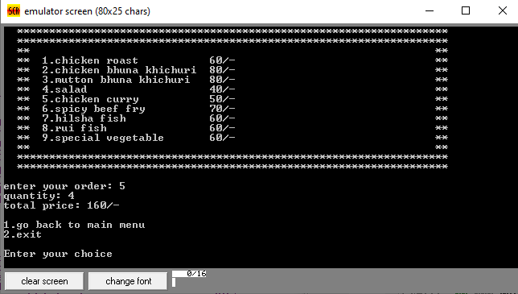
We want to order “Chicken birani” so , clicked 2 and Quantity =3
Total price : 270/-
Clicked 1 for go to main menu and clicked 3 for go to dinner menu. And dinner menu is open . we clicked 5 for “Chicken Curry” and Quantity =4
Page 13

Slide 16
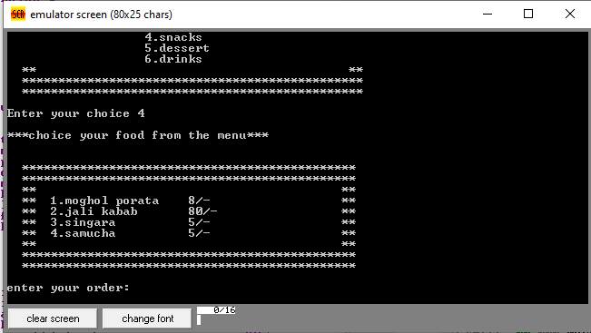
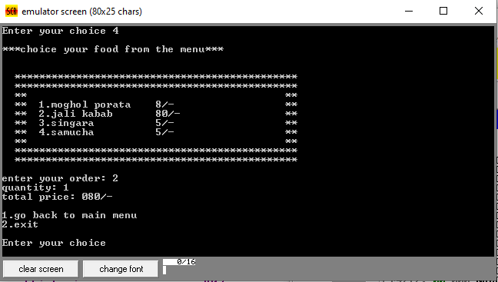
Clicked 1 for go to main menu and clicked 4 for go to snacks menu. And snacks menu is open .
We clicked 2 for “Jali Kabab” and Quantity =1 . Total price : 80/-
Page 14

Slide 17
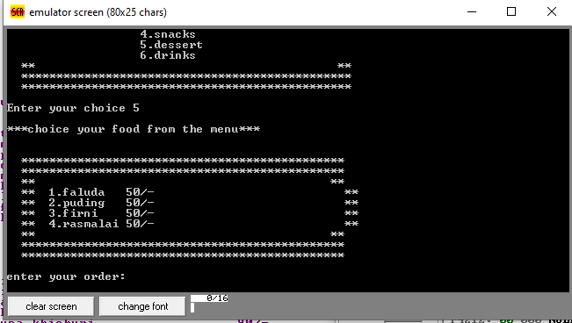
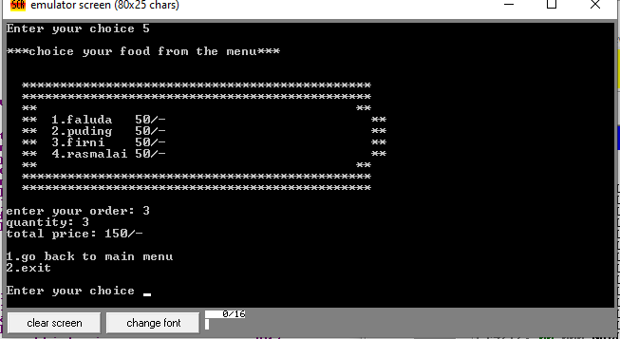
Clicked 1 for go to main menu and clicked 5 for go to dessert menu. And dessert menu is open .
We clicked 3 for “Firni” and Quantity =3 . Total price : 150/-
Page 15

Slide 18
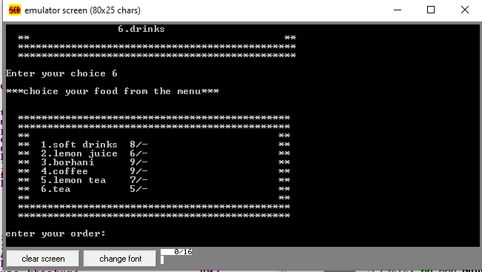
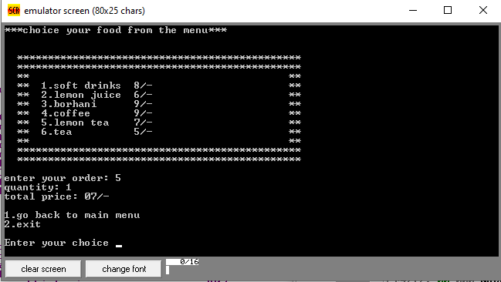
Clicked 1 for go to main menu and clicked 6 for go to drinks menu. And drinks menu is open .
We clicked 5 for “Lemon Tea” and Quantity =1 . Total price : 07/-
Page 16

Slide 19
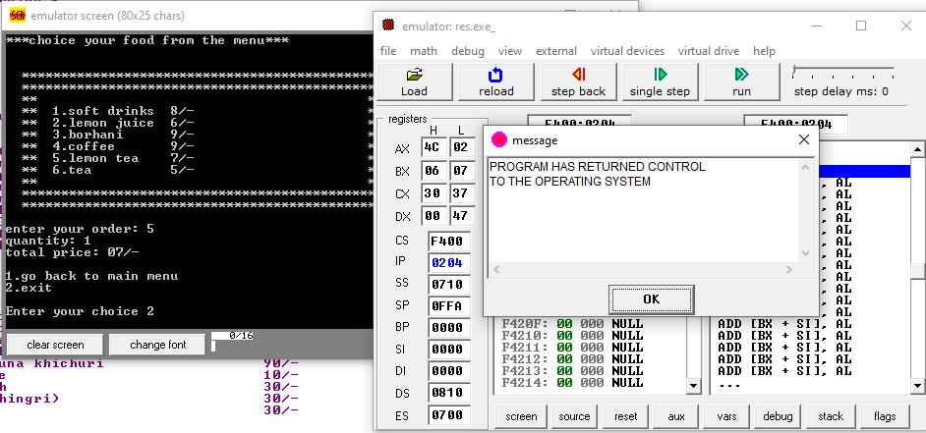
Finally Clicked ‘2’ for go to exit.
Page 17

Slide 20
Chapter 3 Conclusion
Scope of Future Work:
We also want to modify our application for the Future Work .We hope this work will help us in our future work. The application to be developed deals with creating a Restaurant Management System which will automate the major restaurant operations such as generating COD, billing and keeping track of records of daily transaction.
Required software:
For using this project, we need to maintain a software requirement which is given below
a) Emu 8086
b) Operating System
Hardware:
In hardware requirements we require all those components which will provide us the platform for the development of the project. The minimum hardware required for the development of this project is as follows—
Ram minimum 2 GB
Hard disk—minimum 250 GB
Processor- Pentium 1 and Above
Page 18

Slide 21
Results and Discussions
The purpose of our project is to make a restaurant management system . We have able to complete our target. First of all we had faced many problems while completing this project . Although it was difficult at first ,later we have able to complete our project correctly. We have learned a lot from this project and have worked with great pleasure.
Reference:
[1] Wikipedia
[2] Dev.to
Page 19

Slide 22
Thank You

